Slide 1
Hands-On with Amazon Bedrock
Michael Shapira
Sr. Solutions Architect - AWS

Slide 2
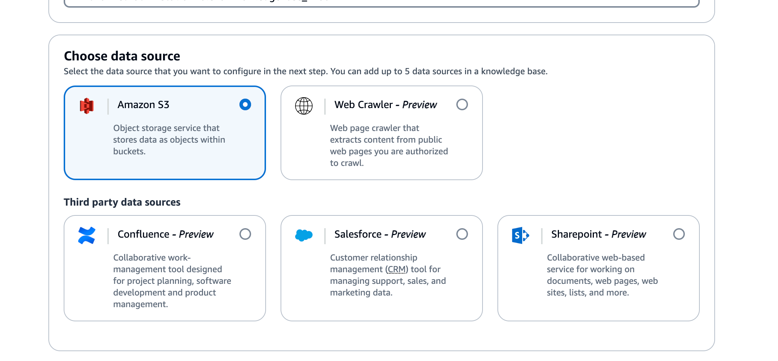
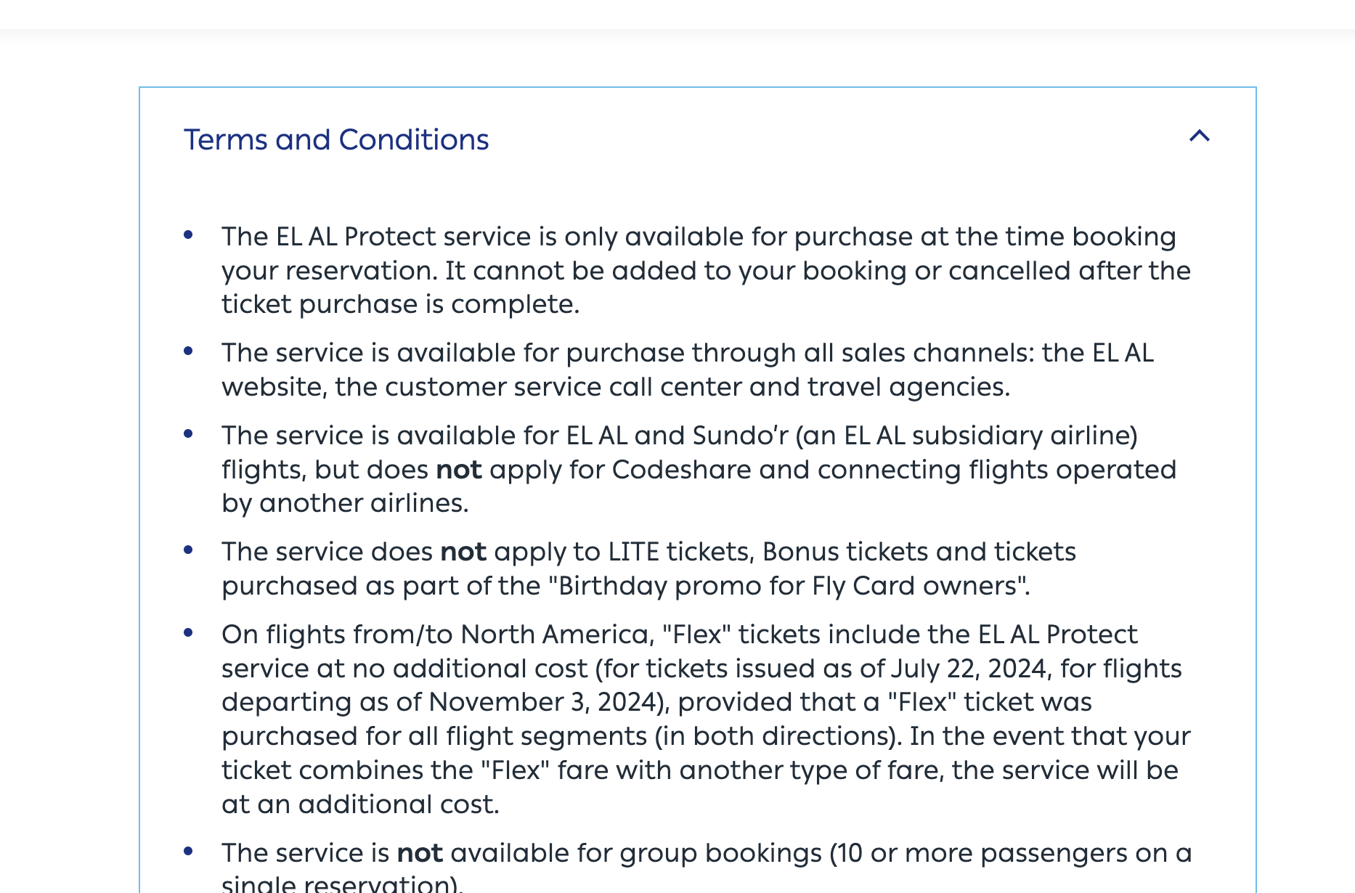
Use-Cases 1 Combine Data from different sources
Use Amazon Knowledge Bases to get the insights from static documents
or/and from Confluent and/or Saleforce
Notes:
Amazon bedrock is a regional service, request and response from bedrock is confined to the region.
Bedrock does not use customer data to train the models. Tiitan or 3rd party.

Slide 3
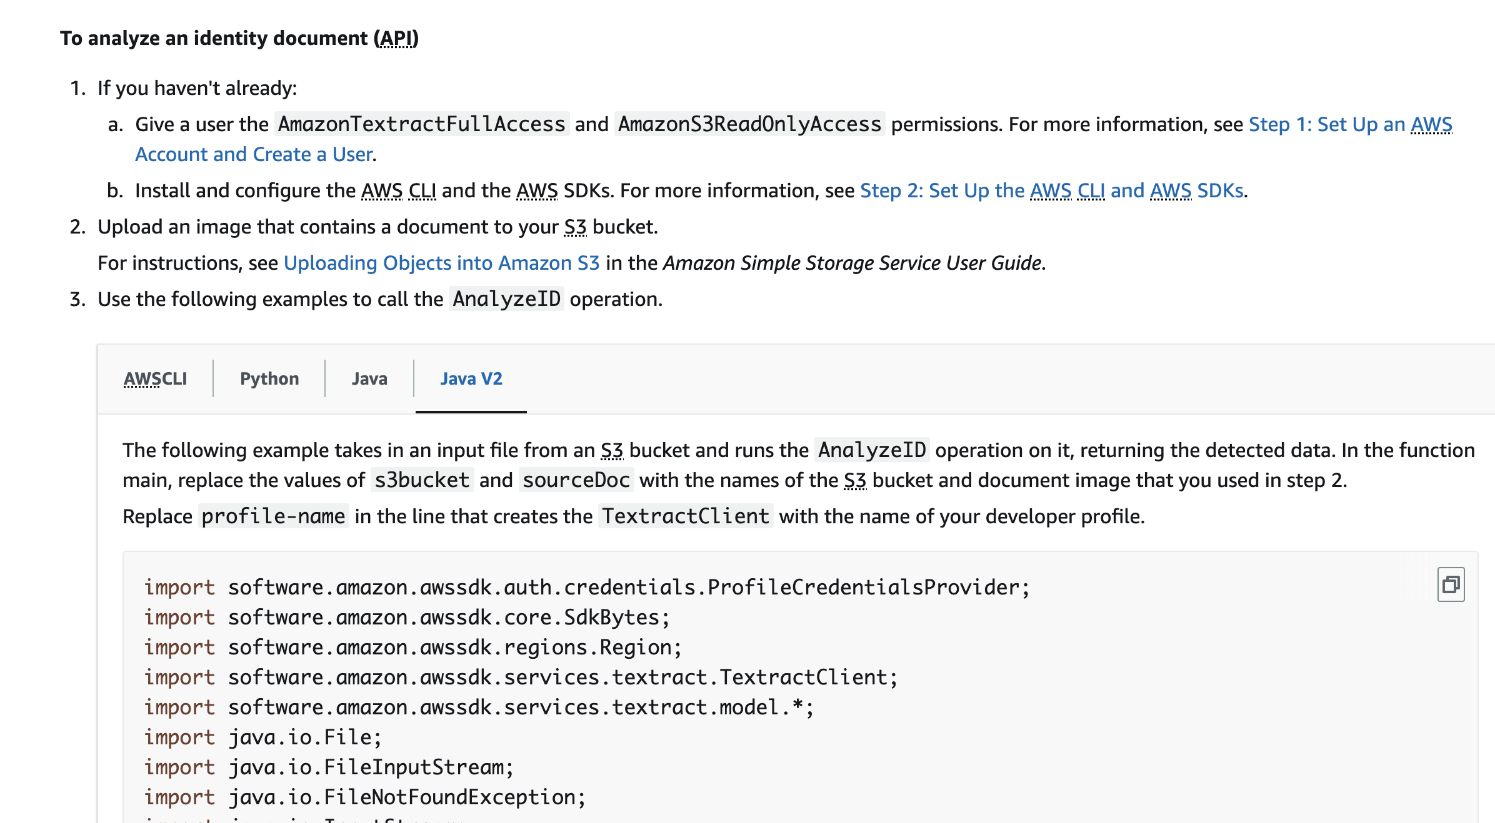
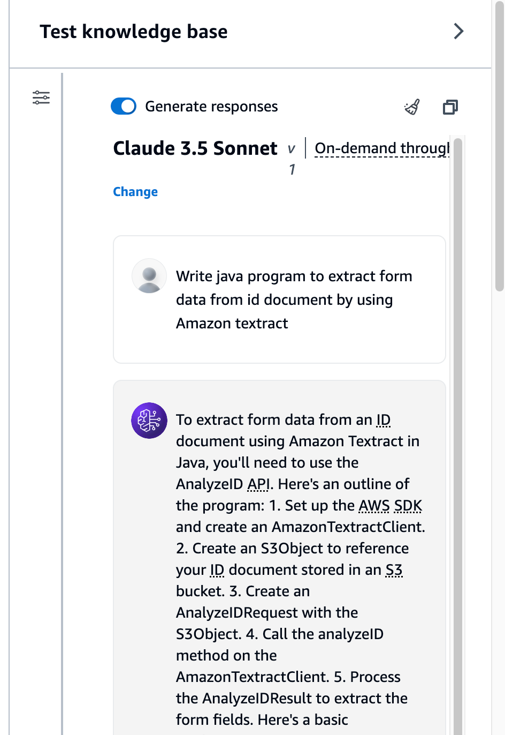
Use-Cases 2 Text to Code and API
Use RAG to guide the developers about how to invoke specific API or provide sample code
Notes:
Amazon bedrock is a regional service, request and response from bedrock is confined to the region.
Bedrock does not use customer data to train the models. Tiitan or 3rd party.

Slide 4
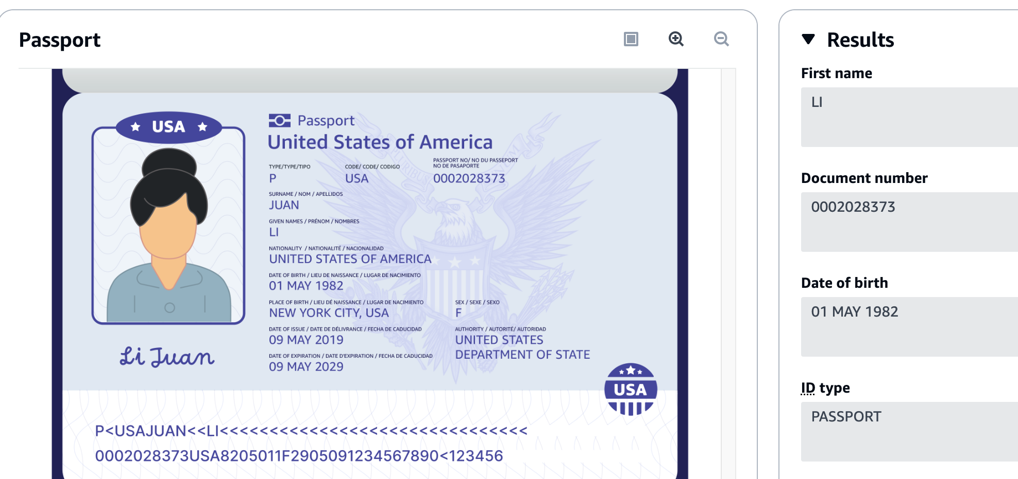
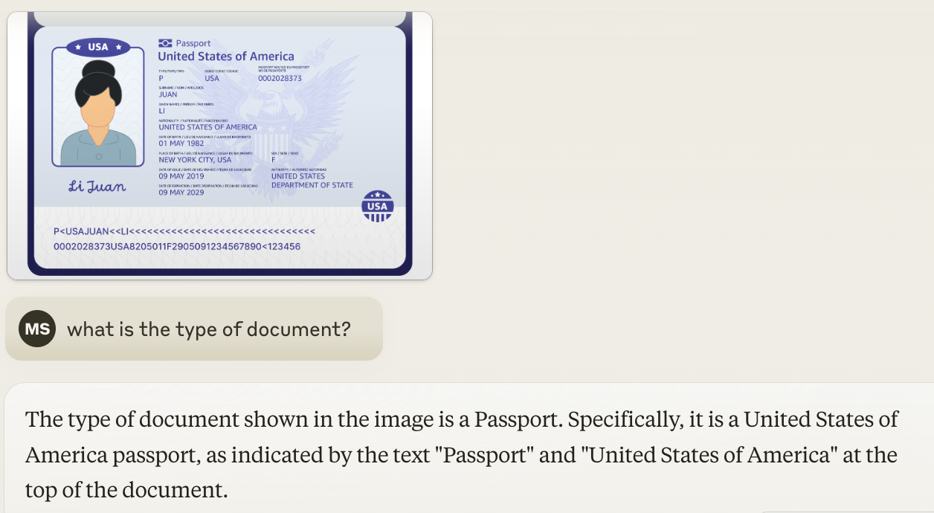
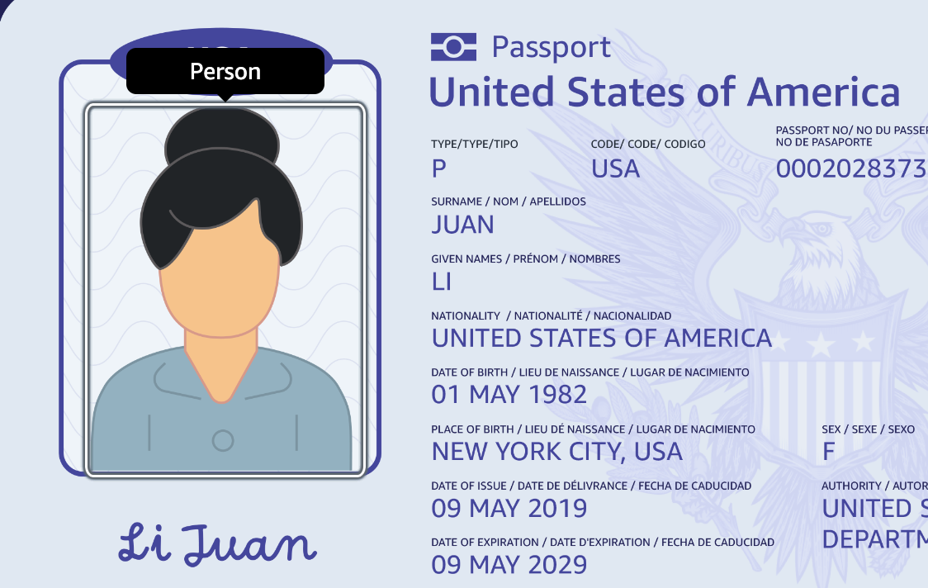
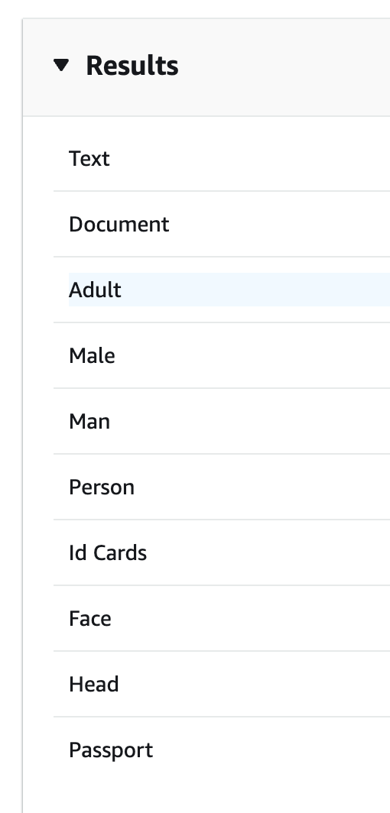
Use-Cases 3 Working with Images
Use Generative AI or Amazon Textract or Amazon Rekognition to get insights from the image
Amazon Textract
Amazon Rekognition
Claude Model
Notes:
Amazon bedrock is a regional service, request and response from bedrock is confined to the region.
Bedrock does not use customer data to train the models. Tiitan or 3rd party.

Slide 5
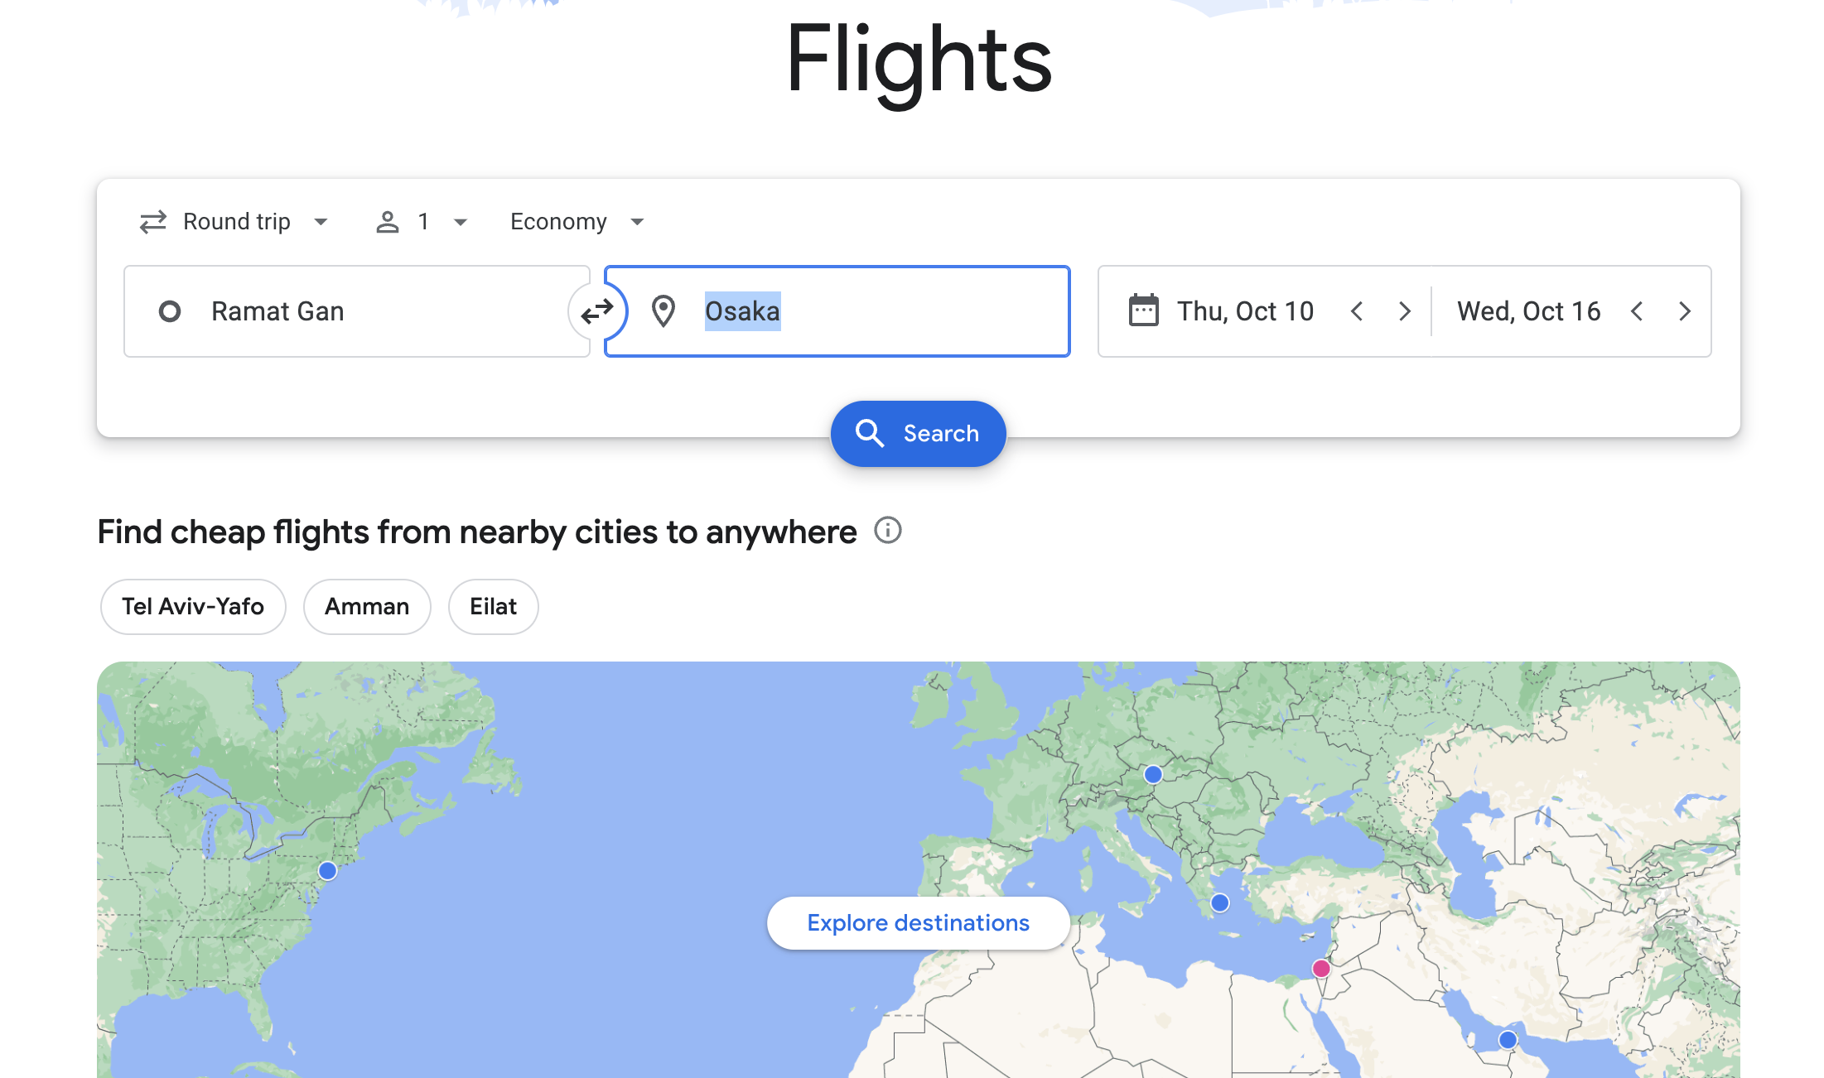
Use-Cases 4 Natural Language for Search
“Find me the flight from Ramat-Gan to Osaka
Find the flights from Ramat Gan to Osaka during July
Notes:
Amazon bedrock is a regional service, request and response from bedrock is confined to the region.
Bedrock does not use customer data to train the models. Tiitan or 3rd party.

Slide 6

Tips – Use Code Samples
https://github.com/MichaelShapira/bedrock-java-samples
Java Code Samples

Slide 7
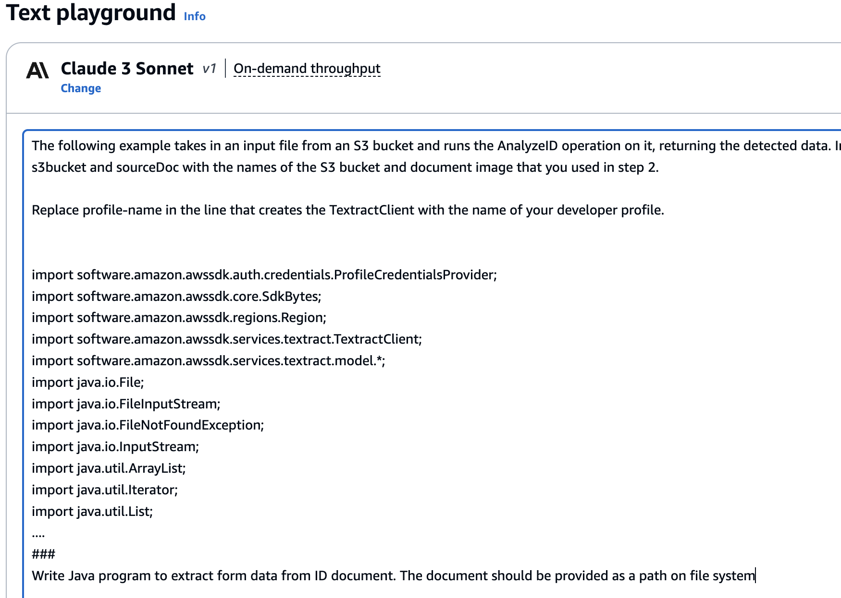
Tips – Start Simple, use playground

Slide 8
Tips – Move Step by step
Find the flights from Ramat Gan to Osaka
Create knowledge base of worldwide aeroports
OR
Query for the list of aeroports in the origin and destination countries
Check what is the closest aeroport to Ramat Gan and Osaka
AND
Query flight API to find the shortest or cheapest plan
Use Agents or use standard development approach or combination of both

Slide 9
Thank you
Michael Shapira
michshap@amazon.com
https://www.linkedin.com/in/mi-sha/

Slide 10
Presentation slide examples and best practices
ABD229-S
Sponsored by anycompany
Ana Carolina Silva
(she/her)
Senior Solutions Architect
AnyCompany

Slide 11
Set the stage with an agenda slide
01 | Where we were | 05 | How we solved the problem
02 | Our proposed solution | 06 | Where we are today
03 | Our roadmap to the solution | 07 | How this can help you
04 | Key steps we took and decisions we made

Slide 12


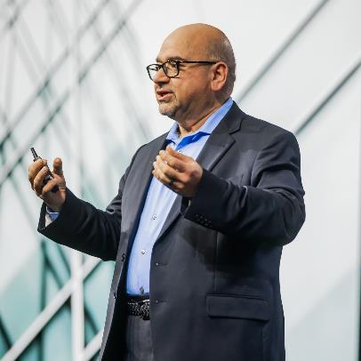
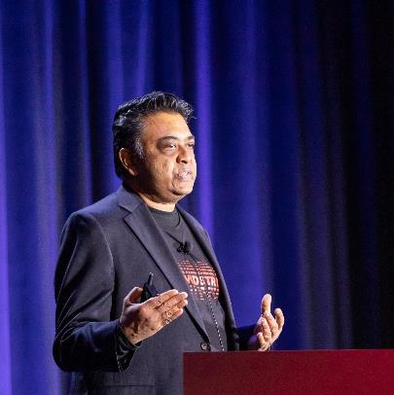
Use high-quality headshots to introduce speakers
Speaker name
Speaker name
Speaker name
Speaker name
(pronouns) Speaker job title Speaker company
(pronouns) Speaker job title Speaker company
(pronouns) Speaker job title Speaker company
(pronouns) Speaker job title Speaker company

Slide 13
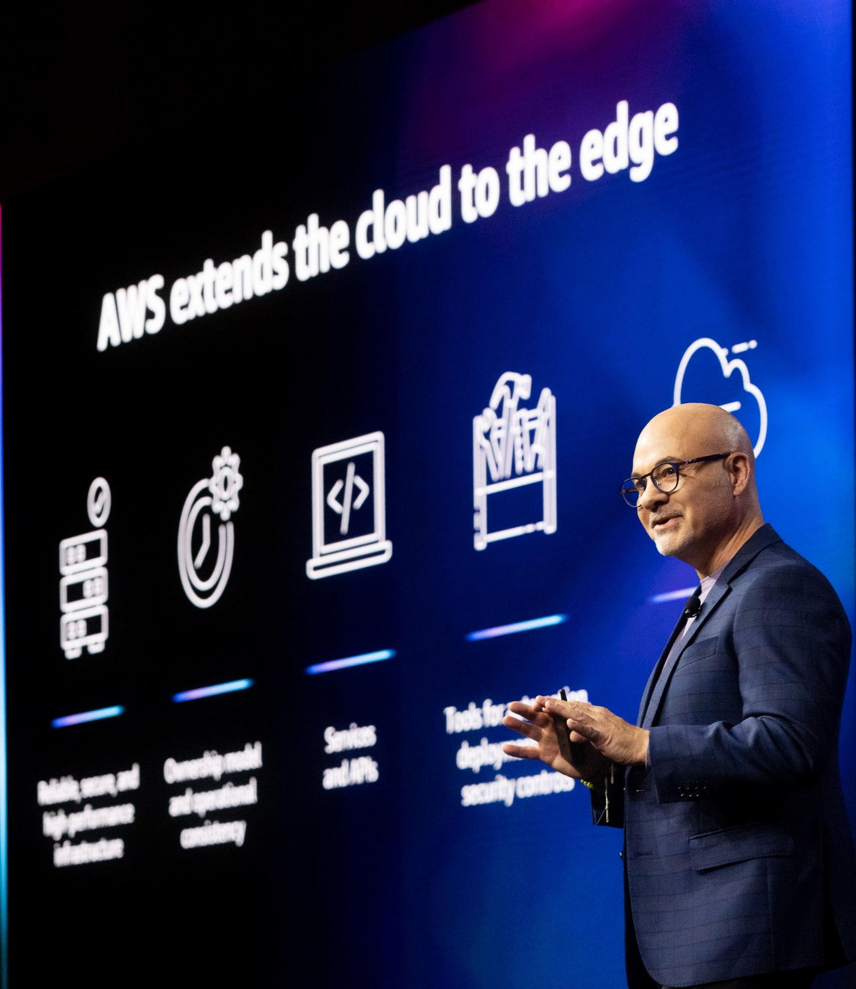
Good presentations
Are customer-focused
Are true to the abstract
Provide clear takeaways
Tell a story
Have simple visuals
Have one key message per slide

Slide 14
Great presentations follow accessibility guidelines
Text (or lines) and the background should have a contrast ratio of at least 4.5:1
Generally, white or black on a strongly contrasting background is the best choice
Here’s some color choices with good contrast for this template
Review the Microsoft PowerPoint Accessibility hub for the latest PowerPoint accessibility best practices
When your presentation is complete, use the Accessibility Checker (Review > Check Accessibility)
Fill colors for black text
16:1
6:1
19:1
Fill colors for white text
14:1
6:1
5:1

Slide 15






Design accessible slide diagrams
Keep it simple Keep diagrams as simple as possible; split content over several slides if needed.
Customer experience
Campaign & journey
management
Amazon Connect
Amazon Pinpoint
Use double encoding Label lines and icons. Avoid using color as a sole indicator of difference.
Data
pipeline
Historical reporting & analytics
Real-time dashboards
Use alt text thoughtfully Include alt text on visuals to briefly describe the content.
Data repository
ETL
ETL
Amazon QuickSight
Amazon S3
Amazon Redshift
Amazon OpenSearch Service

Slide 16




Use icons to visualize your key points
Use icons that emphasize meaning
Use icons sparingly in your content
Don’t overcrowd icon slides with text
Evenly space content on the slide
Use color to add visual interest or emphasis

Slide 17
Chunking text under icons helps your audience absorb the information
Key point
Key point
Key point
Key point
Describe what this icon represents and why that is important
Describe what this icon represents and why that is important
Describe what this icon represents and why that is important
Describe what this icon represents and why that is important

Slide 18




Use high-quality graphics that you own or have permission to use
Icons
Images
Animations
Download AWS architecture icons
AWS speakers can download brand icons and AWS logos from the AWS design portal
AWS speakers, join the Amazon Adobe Stock account to find and license images
Only use images and screenshots from third-party sources if you have permission
Use simple, subtle animations as needed to direct audience attention and clarify relationships
Avoid dramatic animations (such as “Random Bars,” “Bounce,” or “Spin”)

Slide 19




Use quotes to highlight customer voices or inspire your audience.
Quoted person’s name
Quoted person’s affiliation
© 2024, Amazon Web Services, Inc. or its affiliates. All rights reserved.

Slide 20
Don’t use the default PowerPoint tables
Use this preformatted model as a guide to keep tables simple and in line with branding
Data tips | Table tips | Table formatting | Table don’ts
Be honest and precise | Remove clutter | Left align | Don’t use tiny text
Make a point | Emphasize message | Use consistent sizes | Don’t include it all
Use the right method | Keep it short | Use visible colors | Don’t overcomplicate
Visit the PowerPoint Accessibility hub for best practices for creating accessible tables
AWS speakers, you can also review the PowerPoint Accessibility Checklist wiki for table best practices

Slide 21




Keep learning more about presentations
Use QR codes to make resources more accessible during your session
QR code generator
AWS speakers only
Microsoft PowerPoint Help & Learning site
Essential basics on using PowerPoint from Microsoft
The World of Presentations podcast
Conversations with industry experts about PowerPoint design, mechanics, and presenting
BrightCarbon events
Free webinars on PowerPoint design, presenter skills, and more
AWS speakers, more resources are on the wiki

Slide 22


Thank you
Ana Carolina Silva
@anacarolinasilva
linkedin.com/in/anacarol

Slide 23
How to apply this event template

Slide 24
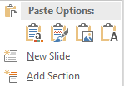
How to add or reuse content
Follow these steps to apply this template to your existing slide deck:
Select all of the slides in the left-hand pane of this template file and delete them (click on one and press Ctrl + A and then Delete).
Open the deck you’ve already created and select all of the slides in the left-hand pane (Ctrl + A) and copy them (Ctrl + C).
In this template file, right-click in the empty left-hand pane and click Use Destination Theme (use this same method to transfer individual slides).
For each slide in your deck, apply the appropriate layout (Home tab > Slides section > Layout).
Reset the slides (Home tab > Slides section > Reset) and ensure all content is in the appropriate placeholders and resets to the correct location. If needed, copy-paste the content into the correct placeholders.
Follow these steps to use this template to create a new slide deck:
Enter your content on the blank slides in the Layouts section and delete any unneeded or hidden slides.
If you want to add more slides, on the Insert tab, select the little arrow under New Slide, and then select your desired layout from the options displayed. Fill out your slide content using the preformatted content placeholders.
End the deck with the Thank You/survey slide.

Slide 25
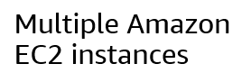
Font/typeface guidance
Font family
Font styling
Only use the Amazon Ember Display font family (with the exception of code, which should use Lucida Console)
Use Amazon Ember Display Heavy for titles, sentence case (sentence-style capitalization)
Use Amazon Ember Display for slide text, sentence case
Do not underline text that is not a hyperlink
Use font sizes that are at least 20 pt. for slide text and at least 12 pt. for diagrams
If using color for emphasis in text, use bold as well
Do these fonts match?
Multiple Amazon EC2 instances
If not, contact the event manager for a font pack

